Slide 1
Plan, Schedule, Test Community Portal
Module Project
Module: Application Implementation (Agile Project Management)
Course:
Start Date :13-07-2023
End Date : 24-07-2023
Submission Date : 24-07-2023
Learner Name : Agung Yuda Pratama
Enrollment ID : BDSE0922-076
Presentation Date : 26-07-2023

Slide 2
Contents
Document History
Version Number | Effective Date of release | Summary of Included Changes | Author
1 | 4th March 2016 | First Edition | Satya CVS
2 | 23rd Jul 2018 | Changed for Module 6 | Shrinivas K R

Slide 3
Contents
Contents
S. No. | Description
01 | Different Types of Testing
02 | How Different Testing Helps
03 | Tests Selected
04 | Test Schedule
05 | Test Results
06 | Testing Tools
07 | Project Milestone & Tasks
08 | Milestone Feedback & Action Taken
09 | Modifications Made Based on Feedback
10 | Project Results
11 | Proposed Improvements

Slide 4
1. Different Types of Testing
List types of Testing
A. Functional Testing
UAT Test (User Acceptance Testing):
User Acceptance Testing (UAT) is a functional testing method. This involves the end user testing the software to verify if it meets their requirements and expectations. UAT ensures systems are aligned with business requirements and ready for production deployment.
Unit Testing
UT is a type of software testing where individual units or components of software are tested. The purpose is to validate that each unit of the software code performs as expected. The developers do Unit Testing during the development (coding phase) of an application. Unit Tests isolate a section of code and verify its correctness. A unit may be an individual function, method, procedure, module, or object.

Slide 5
1. Different Types of Testing
B. Non-Functional Testing
Performance Testing:
A non-functional testing technique is performance testing. It assesses system performance under various circumstances, including load, stress, and scalability. The software must support the anticipated user load and provide a responsive and reliable user experience.
Portability Testing (Multiple Devices / Platforms):
Portability testing is a non-functional testing methodology determining the ease or difficulty of moving a software component or application from one environment to another. The test results obtained from Portability Testing help determine how easily a software component from one environment can be used in another environment.
Compatibility Testing (Cross-Browser Testing):
Compatibility testing, specifically Cross-Browser Testing, is a functional testing method. It ensures the software functions as intended across various web browsers and versions.

Slide 6
2. How Different Test Helps
UAT Test (User Acceptance Testing): Help ensure that the software fulfills what the user wants. Performed by users prior to final release to ensure it fits their needs. Provide valuable feedback for improvements before the official launch.
Compatibility Testing (Cross-Browser Testing): Ensures the software works correctly in different web browsers. Helping developers create a consistent experience for all users. Reducing the risk of problems when people use different browsers to access the software.
Performance Testing: Check how well the software performs under different conditions. Identify any bottlenecks or issues that could slow it down. Helps optimize software for a smooth and fast user experience.
Portability Testing (Multiple Devices / Platforms):Test whether the software can work on different devices and platforms. Ensuring it can be easily moved between different environments. Help make software versatile and accessible to more users.

Slide 7
3. Tests Selected
Functional Testing
UAT Testing
UT Testing
Non-Fucntional testing
Compability Testing
Performance Testing
Portability Testing

Slide 8
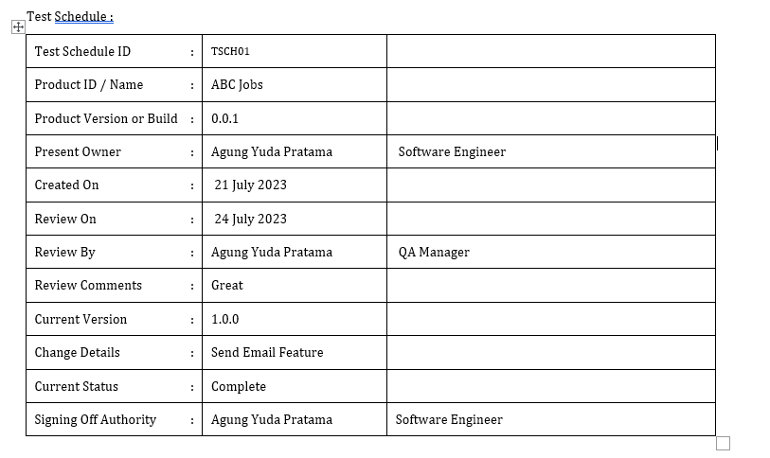
4. Test Schedule

Slide 9
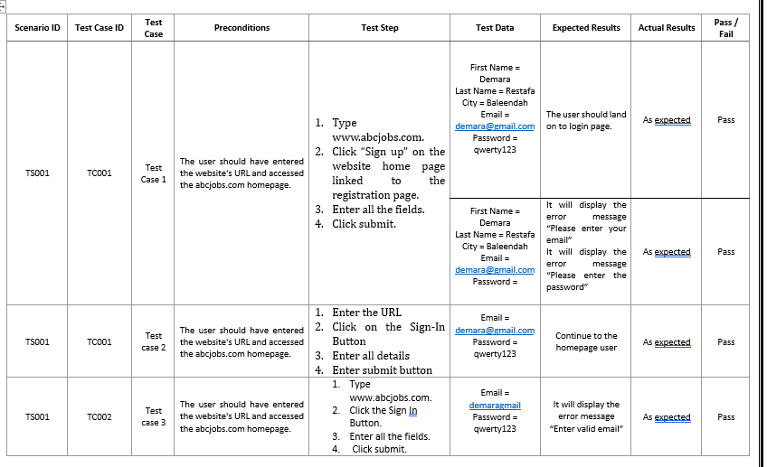
5. Test Results
Unit Testing

Slide 10
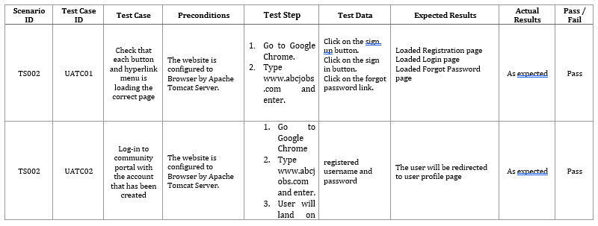
5. Test Results
UAT Testing

Slide 11
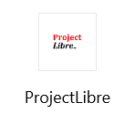




6. Testing Tools
Testing Tools

Slide 12
7. Project Milestones & Tasks
Project Task ID | Project Task Description | Project Milestone ID
1 | Analyze and suggest choice of Test Methods | 1
2 | Schedule the Test Optimally | 1
3 | Develop the Phase Test Plan | 1
5 | Develop Test Cases & Scripts | 2
6 | Execute the Tests & Document the results | 3

Slide 13
8. Milestone Feedback & Action taken
Project Milestone ID | Milestone Feedback received from Tutor / Learning Facilitator | Action Taken (Yes / No)
1
2
3

Slide 14
9. Modifications Made based On Feedback

Slide 15
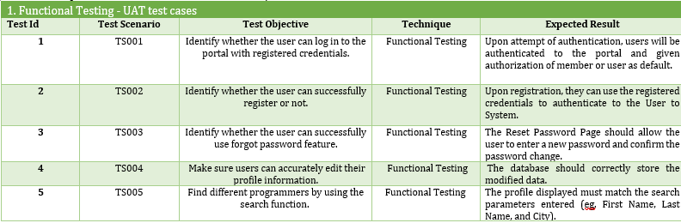
10. Project Results

Slide 16
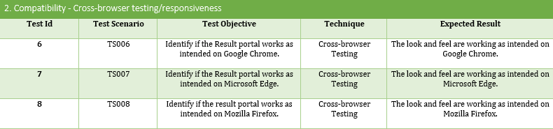
10. Project Results

Slide 17
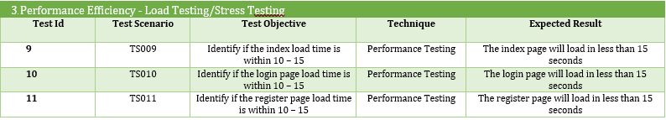
10. Project Results

Slide 18
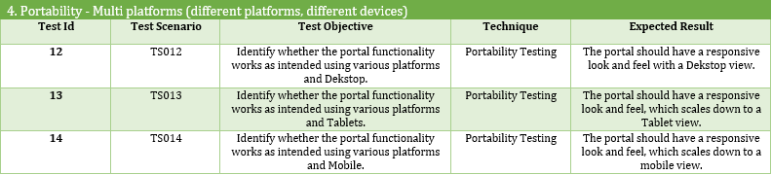
10. Project Results

Slide 19
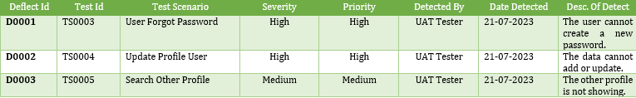
10.Project Result –Defect Report

Slide 20
11. Proposed Improvements
List of Improvements
Update a waterfall model specifically and in accordance with the plan
Try use other SDLC Model and compare with Waterfall model

